Slide 1

Canadian employment trends
Data Saints
Notes:
Hello everyone
Good Morning
We are from Team – Data Saints, students representing St. Clair College - Zekelman School of Information Technology
We are here today to present our analysis on Canadian Employment Trends

Slide 2


Meet the team
Santhosh Narapareddy Rituraj Borah
Bhavita Bhatt Vidya Biradar
Notes:
Please meet our team
Santhosh
Bhavita
Vidya
And Rituraj

Slide 3


DATASET
Main dataset:
Job vacancies, payroll employees, job vacancy rate, and average offered hourly wage
Frequency: Data has been collected by Job Vacancy and Wage Survey (JVWS) on Year-round on a calendar quarter basis, apart from quarters 2 and 3 in 2020, due to the COVID-19 pandemic.
Dataset period : Q1 of 2015 to Q2, 2023.
Survey participation: Mandatory under the Statistics Act
Confidentiality : No information exists that can identify any person, business or organization.
Additional publicly available dataset:
Population estimates, quarterly
Statistics Canada. Table 14-10-0325-01 Job vacancies, payroll employees, job vacancy rate, and average offered hourly wage by provinces and territories, quarterly, unadjusted for seasonality
Statistics Act. Statistics Act (justice.gc.ca)
Statistics Canada. Table 17-10-0009-01 Population estimates, quarterly
Notes:
Our Dataset is : Job Vacancies, Payroll Employees, Job Vacancy rate and Avg Offerd Hourly Wage
This employment data is our choice from the list of datasets provided by the challenge.
Data is collected by Job Vacancy and Wage Survey, every year on a calendar quarter basis, apart from Q2 and Q3 due to the pandemic.
Survey participation is made mandatory under the statistics act.
We have also used population estimates on a quarterly basis.

Slide 4

Analysis questions
What patterns have emerged regarding job vacancies, employment figures, and average hourly wages in Canadian provinces from 2015 to 2023?
Wage Rate
(Hourly Average)
Job Vacancies
Payroll
employment
Which Canadian province(s) has maintained the most stable number of payroll employees since 2015?
Job Vacancy Rate
Is there a Correlation between the number of job vacancies, payroll employees, and hourly wages in Canada?
Notes:
We will be answering following analysis questions
What patterns have emerged for job vacancies, payroll employees and average offered hourly wages?
Which Canadian province(s) has maintained the most stable number of payroll employees since 2015?
Is there a Correlation between the number of job vacancies, payroll employees, and hourly wages in Canada?

Slide 5

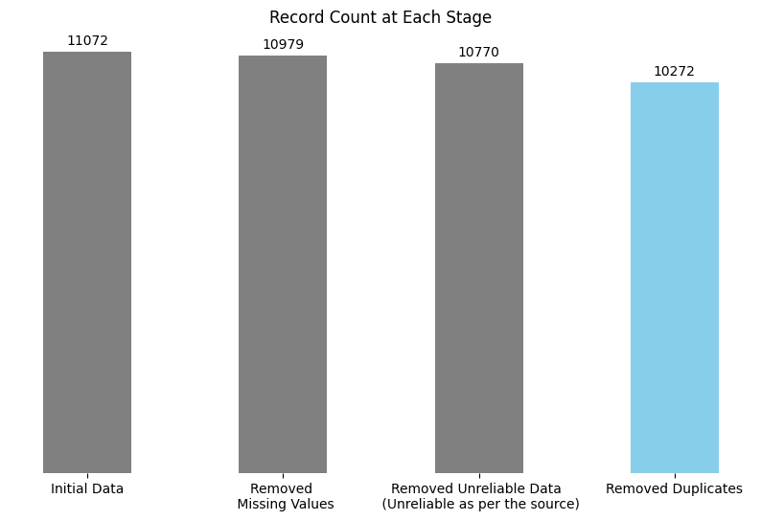
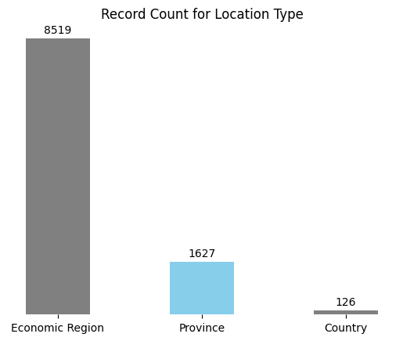
Data cleaning and Preprocessing
Pivoted Rows to Columns
442 Rows
Notes:
For Data processing,
We started with 11,072 rows and ended up with 442 rows,
after Removing missing values, unreliable data as per the source and duplicates and pivoting the rows
We used Province level information as our challenge objective is to compare amongst provinces

Slide 6






Methodology
Filled the missing data of Q2 and Q3 for the year 2020 using average values of Q1 and Q4
Tableau was used to generate visuals, plot regression line and conduct correlation analysis
Statistical measures such as mean, standard deviation and percentage change/difference are used in the analysis
Tested Hypothesis for correlation between job vacancies, payroll employees and average offered hourly wage rate
Notes:
We used Pandas library in python to process the data
We loaded our processed data in Microsoft Excel to fill the missing data of Q2 and Q3 of the year 2020 with average values and created visualisations in Tableau.
Statistical measures such as mean, standard deviation and percentage change or difference have been used in our analysis wherever relevant.
For hypothesis testing, we looked at correlation between each of these variables.
Rituraj will take it forward from here, thank you

Slide 7

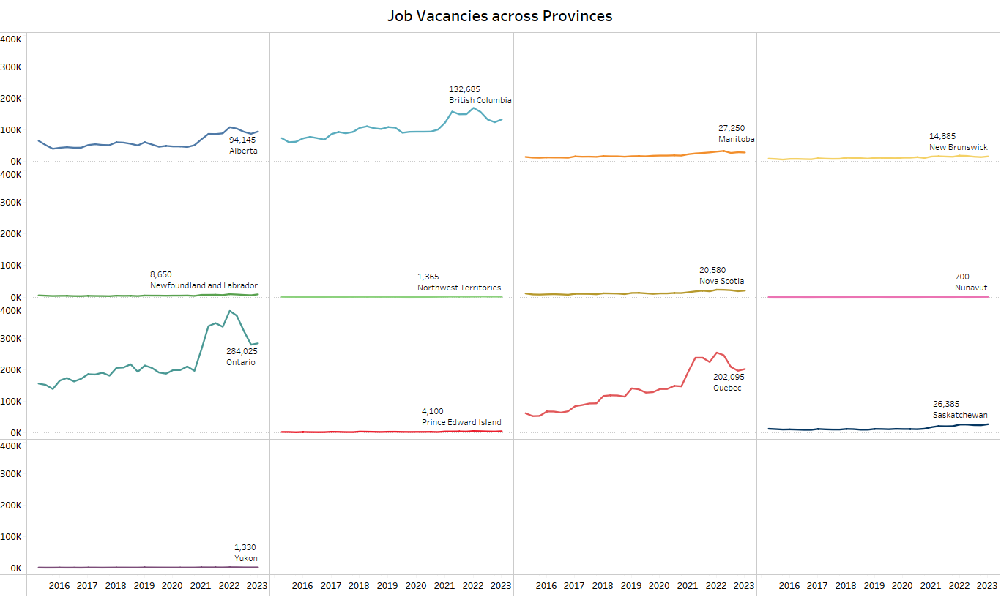
As on Q2 of 2023, Ontario has seen the highest number of job vacancies while Nunavut has the lowest.
Notes:
We would answer our first analysis question about the major trends for each of our variables.
This plot helps us understand the major trend of job vacancies across the provinces of Canada.
From the visual, we can observe that as of 2023, Ontario had the highest number of job vacancies and Nunavut had the lowest number.

Slide 8
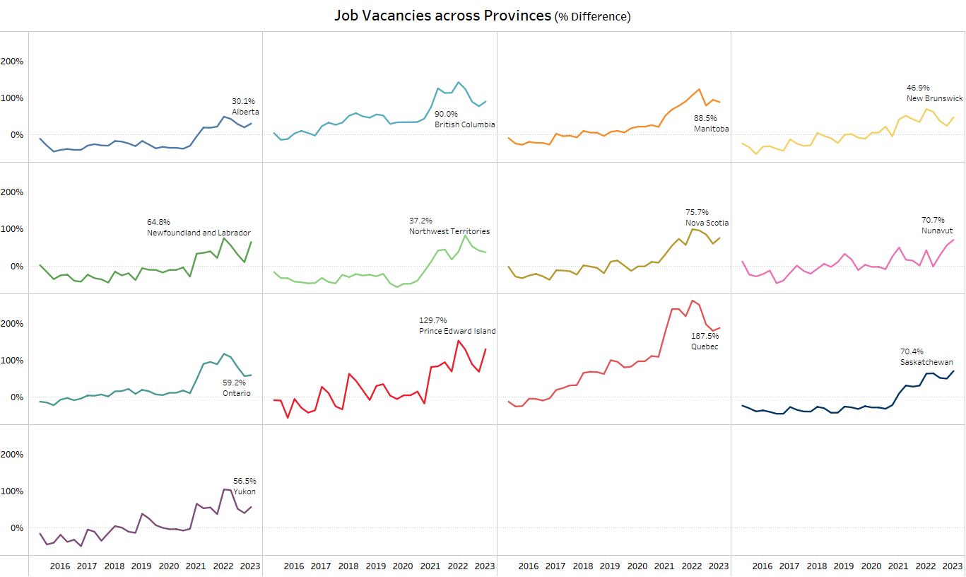
Quebec has seen the highest change in terms of percent change for job vacancies while Alberta remained the lowest.
Notes:
This plot helps us understand the % difference of job vacancies across the Canadian provinces over the years
From the visual, we can observe Quebec had the highest % change in job vacancies and Alberta had the lowest % change.

Slide 9
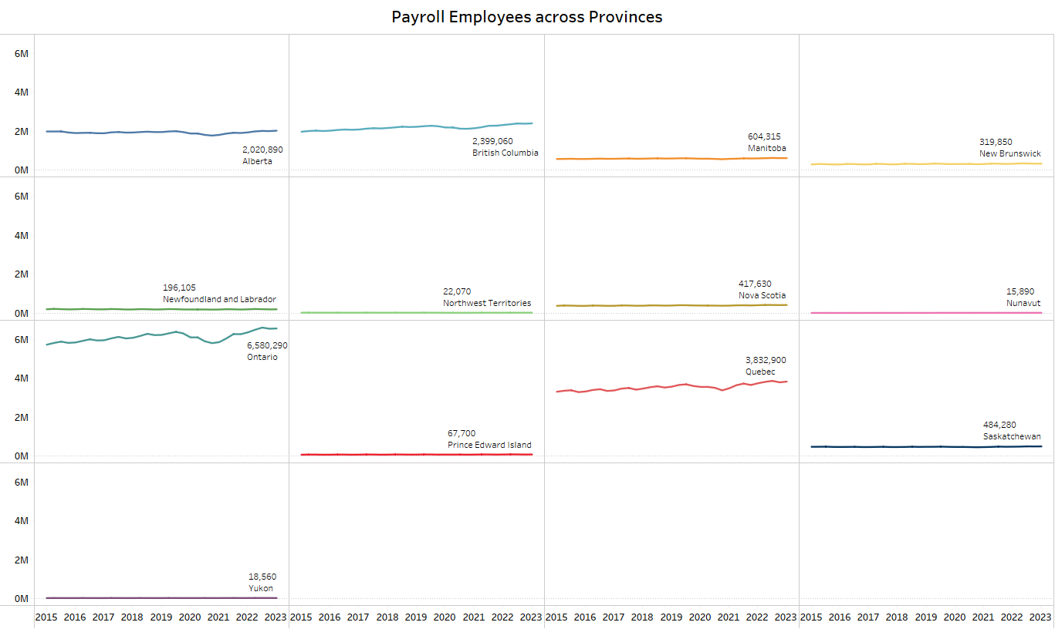
As on Q2 of 2023, Ontario has seen the highest number of Payroll Employees while Nunavut has the lowest.
Notes:
We can look at the major trend for number of payroll employees across the provinces of Canada.
From the visual, we can observe that Ontario had the highest number of employees and Nunavut had the lowest in 2023.

Slide 10
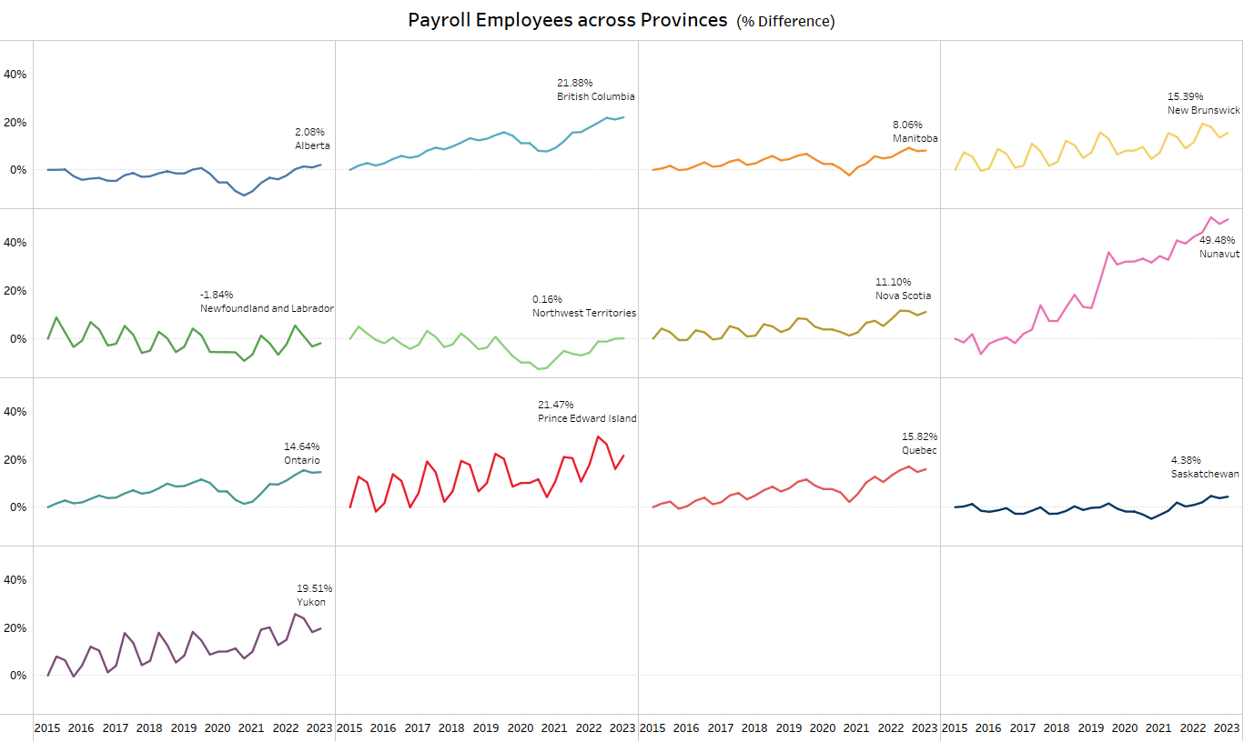
Nunavut has seen the highest change in terms of percent change for Payroll Employees while Newfoundland and Labrador remained the lowest.
Notes:
This plot helps us understand the % difference in number of payroll employees across the Canadian provinces over the years.
From the visual, we can observe Nunavut had the highest % change in number of employees and Newfoundland and Labrador ended up with negative 1.84% being the lowest % change amongst the provinces.

Slide 11
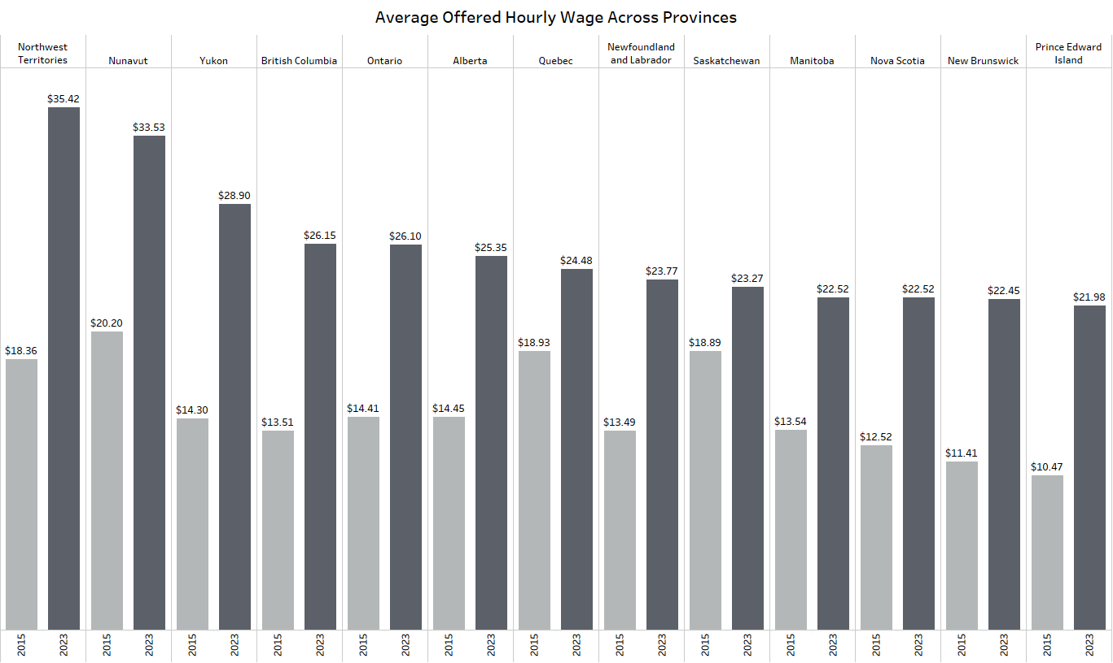
Northwest Territories has the highest wage rate followed by Nunavut, Prince Edward Island being the lowest amongst the provinces.
Notes:
This plot helps us understand the distribution of Average Offered Hourly wages across the Canadian provinces during 2015 and 2023.
From the visual, we can observe that in 2023, Northwest Territories have the highest followed by Nunavut and Prince Edward Island being the lowest amongst the provinces.

Slide 12
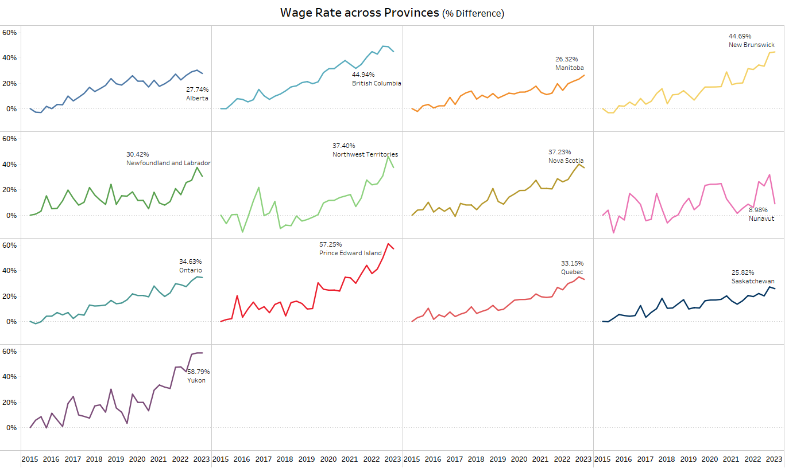
Prince Edward Island has seen the highest change in terms of percent change for Wage Rate while Nunavut remained the lowest.
Notes:
This plot helps us understand the % difference in Avg. offered Hourly Wages across the Canadian provinces over the years.
From the visual, we can observe Prince Edward Island had the highest % change in Avg. offered Hourly Wages at 57.25% whereas Nunavut exhibited the lowest change at 8.98% amongst the provinces.
My teammate Vidya would take it from here

Slide 13
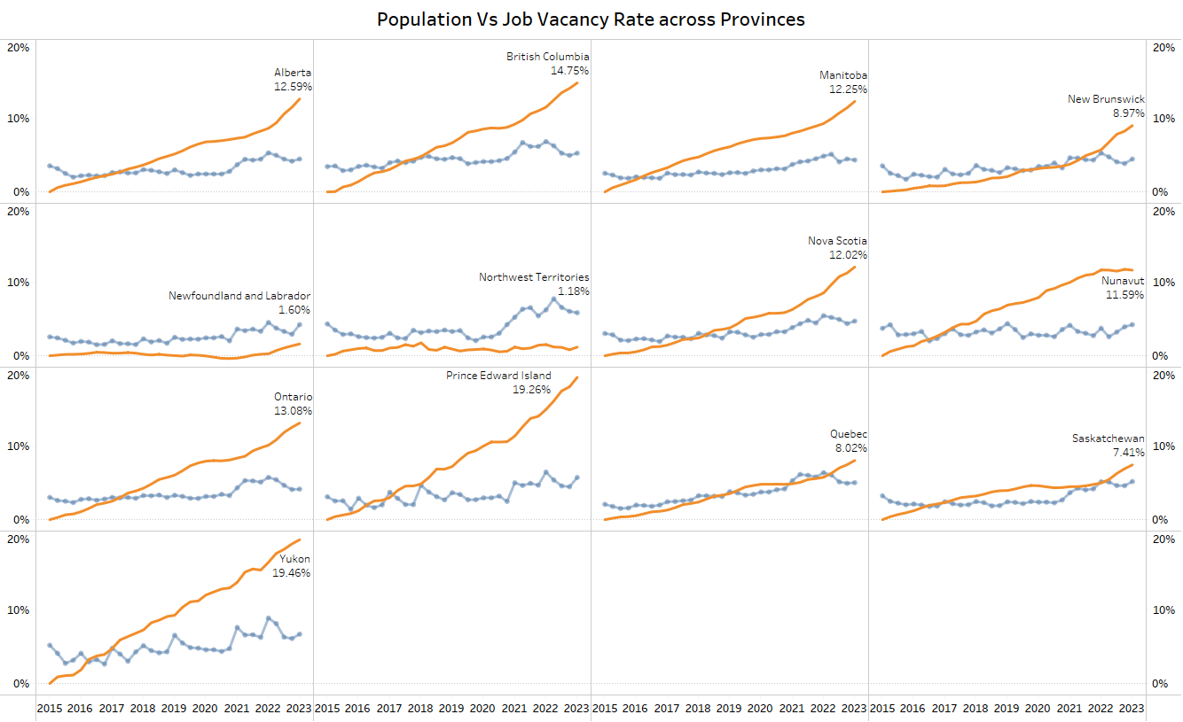
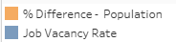
Newfoundland and Labrador, Northwest Territories had low population change rate as compared to job vacancy rate.
Notes:
This plot provides an overview of the relation between %change in Population and Job Vacancy rate across the Canadian provinces over the years.
We can observe that for Newfoundland and Labrador & Northwest Territories , the % change in population remains low compared to job vacancy rate throughout the years amongst the provinces.

Slide 14
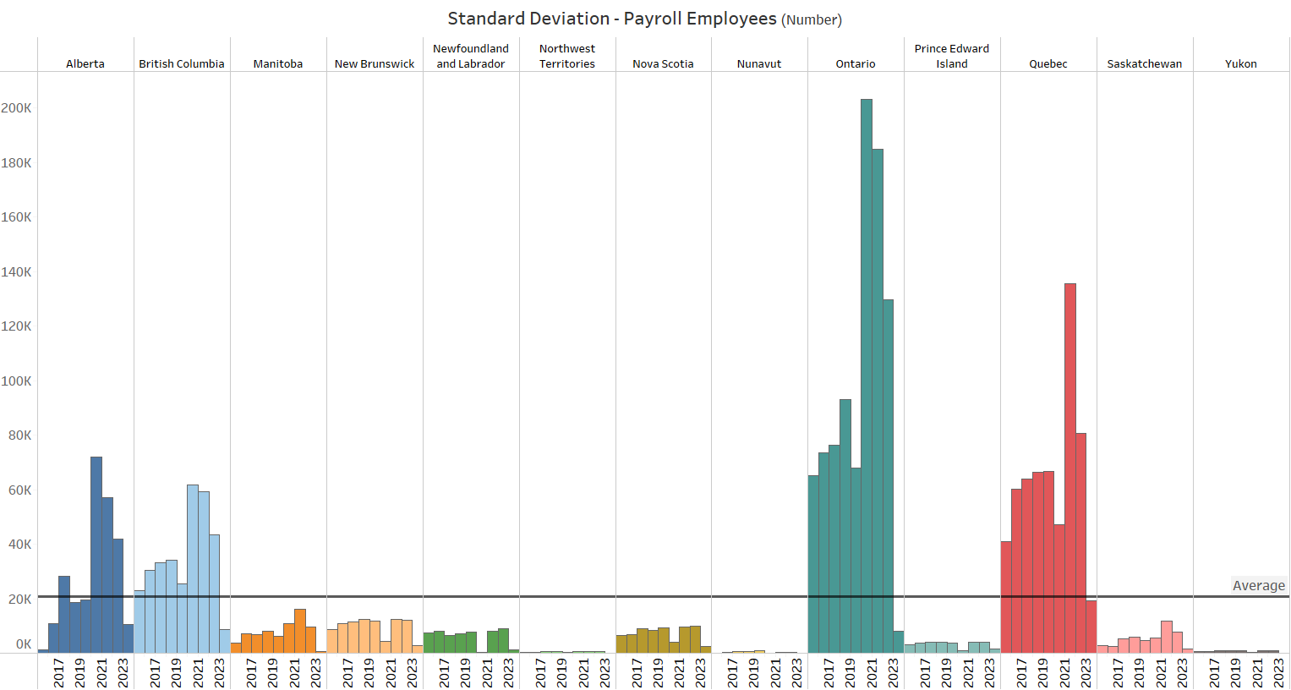
Alberta, British Columbia, Ontario and Quebec have seen the highest standard deviations with values greater than overall average resulting in better stability in terms of employee opportunities.
Notes:
We would answer our 2nd analysis question about the most stable provinces for number of payroll employees.
From the visual, we can observe that Alberta, British Columbia, Ontario and Quebec have seen the highest standard deviations with values greater than overall average resulting in better stability in terms of employee opportunities.

Slide 15
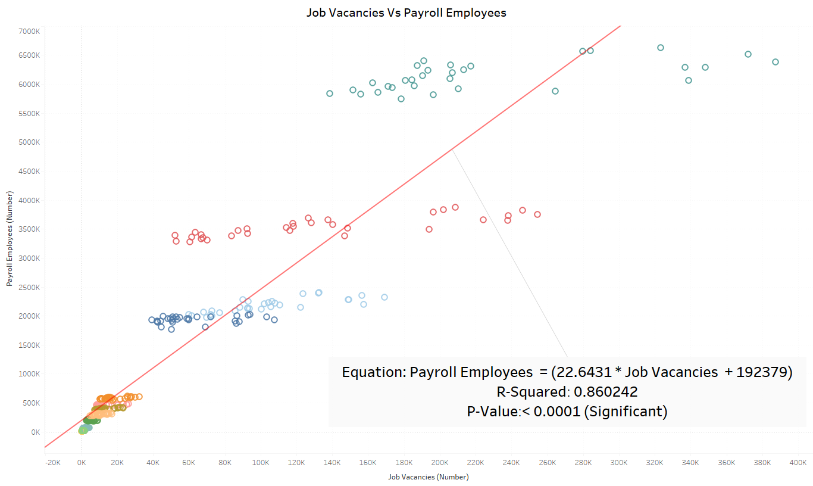
Hypothesis Testing
H₀ = There Is A Strong Correlation Between Job Vacancies, Employment And Hourly Wages
There is a Strong correlation between job vacancies and payroll employees.
Notes:
Now, we would like to answer our 3rd analysis question using Hypothesis testing.
Our Hypothesis states that “There Is A Strong Correlation Between Job Vacancies, Employment And Hourly Wages”.
We would look at scatter plots of these pairs to check the linearity and understand if they are correlated using Pearson’s R and P-value that is our test of significance.
From the visual, we can observe that Pearson R value is 0.86 and p-value lower than 0.0001
We can understand that there is a strong correlation between Job vacancies and Payroll employees.

Slide 16
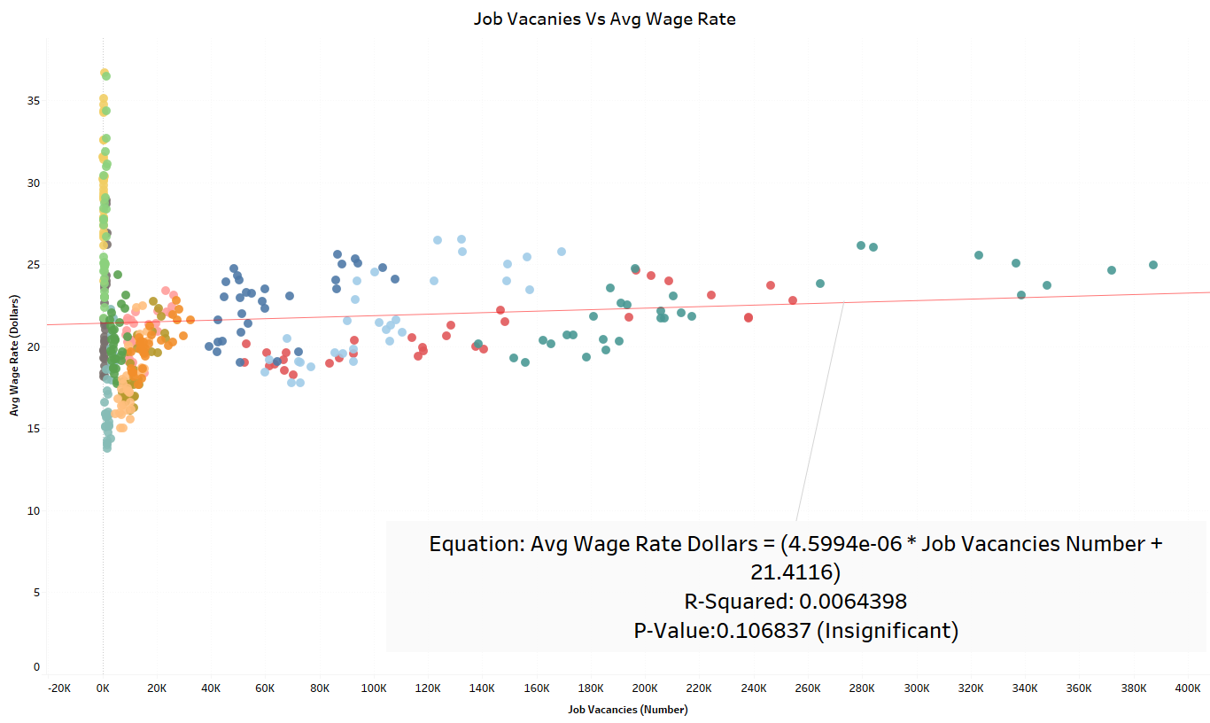
Hypothesis Testing
H₀ = There Is A Strong Correlation Between Job Vacancies, Employment And Hourly Wages
There is a no correlation between job vacancies and wage rate
Notes:
Continuing our hypothesis testing for the second pair,
We can observe that Pearson R value is 0.006 and p-value is 0.1068.
We can infer that there is no correlation between Job vacancies and Average Wage rate in dollars.

Slide 17
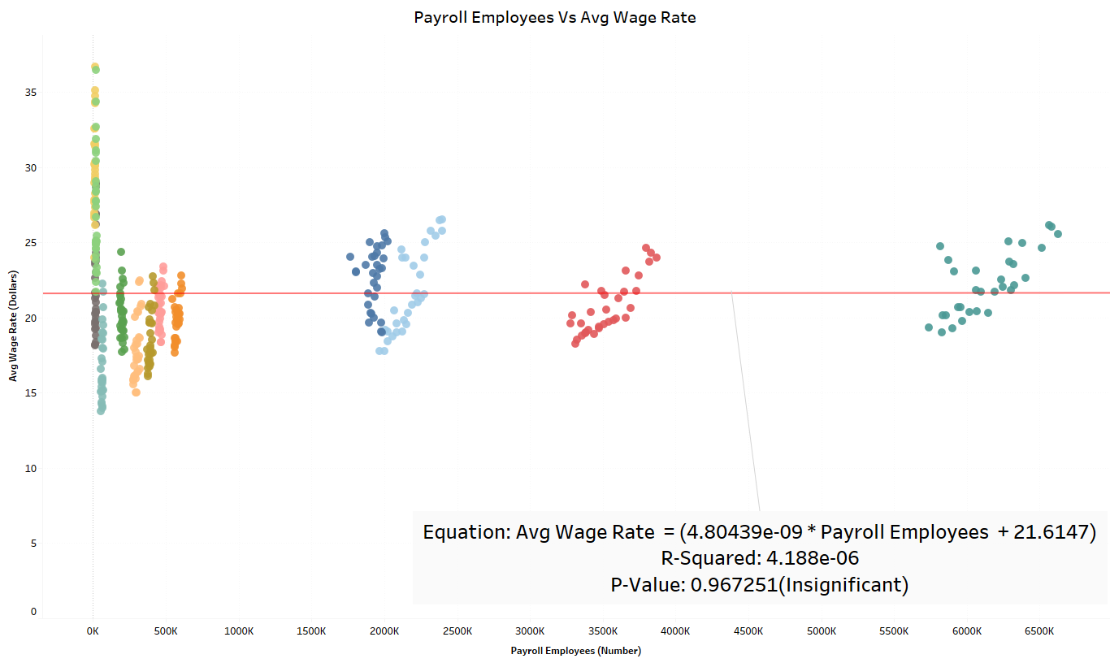
Hypothesis Testing
H₀ = There Is A Strong Correlation Between Job Vacancies, Employment And Hourly Wages
There is a no correlation between payroll employees and wage rate
Notes:
Continuing our hypothesis testing for the third pair,
We can see that Pearson R value is negligible and p-value is 0.9672
We can infer that there is no correlation between Payroll employees and Average Wage rate in dollars
My Teammate Bhavita will take it from here
Negligible? - (4.188 ten to the power of negative six) it is negligible since it is in exponential.

Slide 18
Hypothesis Testing
Is there a correlation between the number of job vacancies, payroll employment, and hourly wages in Canada? H₀ = There Is A Strong Correlation Between Job Vacancies, Employment And Hourly Wages.
H_{A} = There Is No Strong Correlation Between Job Vacancies, Employment And Hourly Wages.
We reject the Null Hypothesis as our analysis failed test of significance
There is no strong correlation between Job Vacancies, Employment and hourly wages
Notes:
We reject our null hypothesis as it failed the test of significance for two pairs and accept the alternate hypothesis :
There is no strong correlation between Job Vacancies, Employment and hourly wages.

Slide 19

Insights | Recommendations
Province | Insight | Recommendation
Ontario Quebec | Highest number of job vacancies. Significant increase in % change in job vacancies | Opportunity for job seekers to explore role
Nunavut Alberta | Job market is stable, but no growth observed. Market is slow as % change is low amongst the provinces. | Implement strategies to increase employment opportunities.
Job
Vacancies
Wage Rate
(Hourly Average)
Payroll
employment
Notes:
Here are the insights and recommendations for the Job vacancies
Ontario has the highest number of job vacancies whereas there has been a significant increase in terms the of percentage of job vacancies in Quebec.
For these two provinces, It is an excellent opportunity for the job seekers to explore the various job roles.
Moreover, For the province Nunavut job market is stagnant yet no growth has been observed. Similarly market of Alberta is slow as the percentage change is low amongst the provinces. Implementation of strategies to increase employment opportunities is required for both of the provinces.

Slide 20
Insights | Recommendations
Province | Insight | Recommendation
Ontario Nunavut | Highest number of employees Significant % change observed | Diversifying skills or business operations could be advantageous
Nunavut Newfoundland and Labrador | Lowest number of employees Negative change observed | Promotion and implementation of policies that can generate employment opportunities
Job
Vacancies
Wage Rate
(Hourly Average)
Payroll
employment
Notes:
Payroll employment insights is presented here
Ontario has the highest number of employees and there has been significant percent change observed in terms of payroll employment for the province Nunavut. Both province should diversify skills or business to gain more advantage
Nunavut has lowest number of employees where as negative change in payroll employment is observed for Newfoundland and Labrador . Focusing more on promotion and implementation of policies that can generate employment opportunities.

Slide 21
Insights | Recommendations
Province | Insight | Recommendation
Northwest Territories Prince Edward Island | Highest average offered wage rates observed for the year 2023 Highest % Change in Average offered wage observed | Important for hiring negotiations and contract renewals Comprehend the reason for highest % change with a lower wage for the year 2023
Nunavut Prince Edward Island | Lowest change in average offered wage rates observed Lowest wage rate per hour observed for the year 2023 | Initiatives needed to improve wages for better satisfaction and retention
Job
Vacancies
Wage Rate
(Hourly Average)
Payroll
employment
Notes:
When we talk about wage rate,
Northwest territories have highest average offered wage rates observed for the year 2023. It’s important for hiring negotiations and contract renewals.
Highest % Change in Average offered wage observed was for the province Prince Edward Island. There is need to Comprehend the reason for highest % change with a lower wage for the year 2023
Nunavut has Lowest change in average offered wage rates observed. Also for Prince Edward Island Lowest wage rate per hour observed for the year 2023 , Both Province should to improve wages for better satisfaction and retention

Slide 22

Notes:
So Here we are concluding our presentation. Thank you for providing the opportunity.

